Slide 1
Dear Diary
Milestone I – Andreas Gruber

Slide 2
Agenda
Finished Tasks
File Structure
To-dos
Challenges
Upcoming Features

Slide 3
Update I - Finished Tasks
Register/Login/Logout
Switching between login and register
Password matching with special characters
Forward to dashboard when already signed in
Dashboard
Created logo and background images
Created and styled memory entries
Create dynamically memories from templates
Automatically put the memories in the correct sections
Clicking trough memories
Created and styled popup to enter new memories
Responsive styling
Sqlite
Created Sqlite db with tables
Sqlite connection

Slide 4
Update II - Finished Tasks
Dashboard
Creating tags via enter click
Delete tags via click on x-symbol
Edit Memory -> open dialog (same as saving)
Update & delete icons + styling
Sqlite
Created insert and (update) statement
Created delete statement

Slide 5

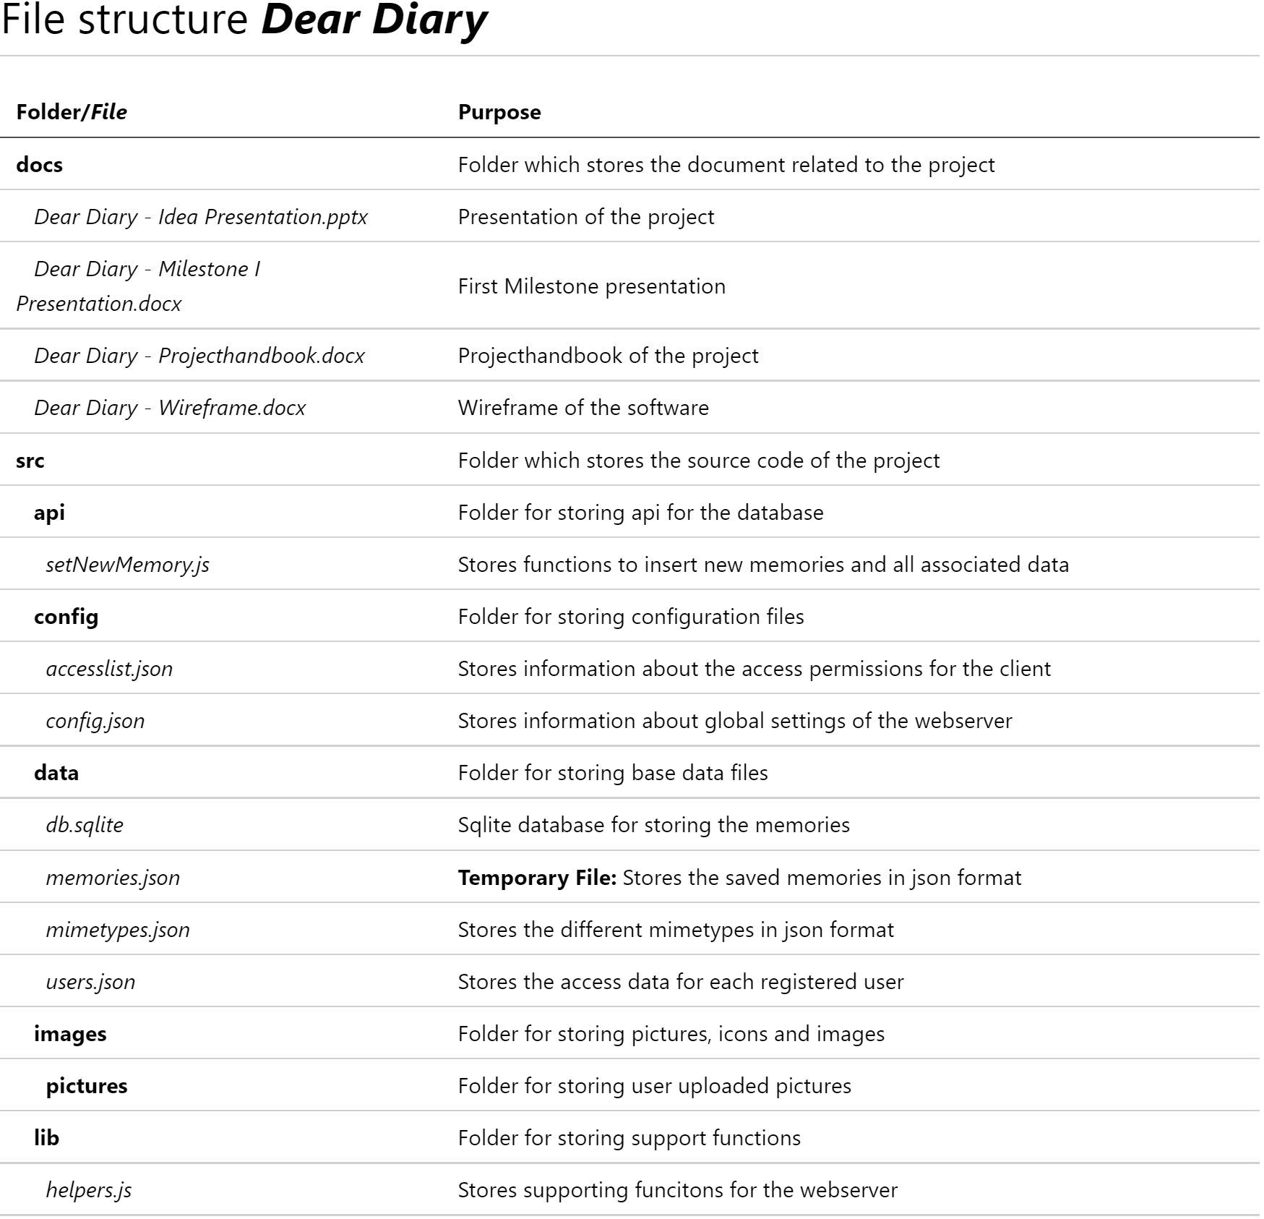
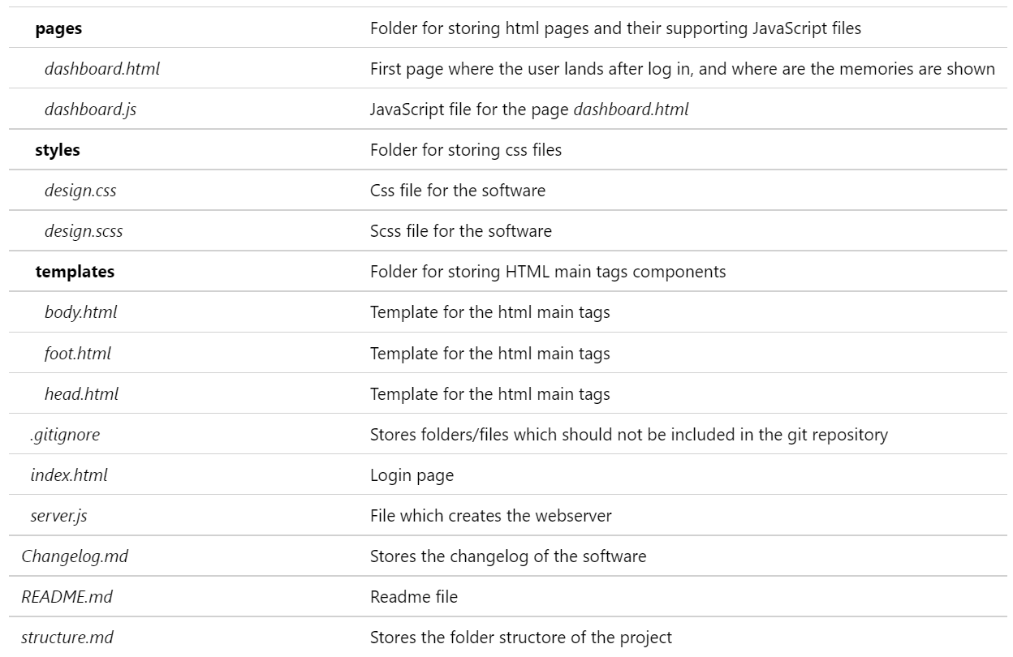
File Structure

Slide 6
To-dos
Remove Arrow (last/first element)
Load memories from the sqlite db
Image upload
Finish deleting memories
Filter & Search memories
Nice to have
Animate Dashboard
Google Places API

Slide 7

Challenges
Keep code clean
Wording algorithm x days/weeks/months/years ago…
The bigger the code get, the more confusing it gets
Complex to create the logic for the wording how long ago the memory was

Slide 8
Upcoming features
Image upload with preview (multiple)
Article scroll-snap
Toggle arrow left/right

